Slide 1
“Brain Connectomes,
Genetics, Epigenetics,
Early Development
of Psychopaths”
HJSA Conference
April 7 2016 Omaha
James Fallon, Ph.D.
Professor
Dept Psychiatry and Human Behavior
University of California Irvine

Slide 2
THREE DISCUSSIONS TODAY
Keynote:
PERSONAL STORY
Breakout session:
BASIC SCIENCE
3) Breakout session: PSYCHOPATHY IN THE WORLD

Slide 3
2) Breakout session:
BASIC SCIENCE

Slide 4
Human genome
22 autosome pairs + 2 sex chromosomes
3 billion base pairs in the haploid genome
Where and what are the 23,000 genes?
Is there anything else interesting/important?
From NCBI web site, photo from T. Ried,
Natl Human Genome Research Institute, NIH

Slide 5
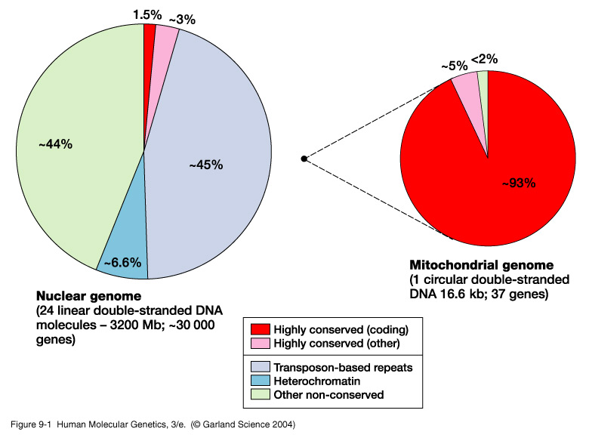
Mitochondrial genome
16,569 bp
37 genes
NUCLEAR GENOME
24 distinct chromosomes (22 autosomal + X + Y)
3,200 Mbp
23,000 genes

Slide 6
A view of the genome... (circa yr 2,000)
SNP
Coding gene…

Slide 7
A view of the genome... (… today)
RNASeq: Transcripts, splicing, expression profiling
Methylation
SNP
Histone
Modifications
Promoter
CAGE Seq
Insulator CTCF ChIP Seq
Non-coding RNA
RNASeq
Non-coding RNA
Enhancer
P300 ChiPSeq
Coding gene…
[from E. Stupka - UCL]

Slide 8
A view of the coding genome...
2%
Coding gene…

Slide 9
… and a view of the non-coding genome
RNASeq: Transcripts, splicing, expression profiling
98%!
Methylation
SNP
Histone
Modifications
Promoter
CAGE Seq
Insulator CTCF ChIP Seq
Non-coding RNA
RNASeq
Non-coding RNA
Enhancer
P300 ChiPSeq
[from E. Stupka - UCL]

Slide 10
WHAT “GENETICS” UNDERLIE PERSONALITY,
BEHAVIOR, AND PATHOLOGY?
THAT IS, HOW DOES GENETICS
DETERMINES IDENTITY, SELF?
IDENTICAL TWINS TO THE RESCUE>>>>>>>

Slide 11
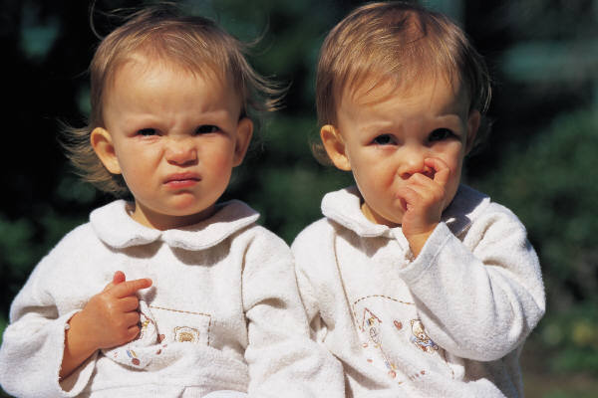
Identical twins are genetically identical

Slide 12
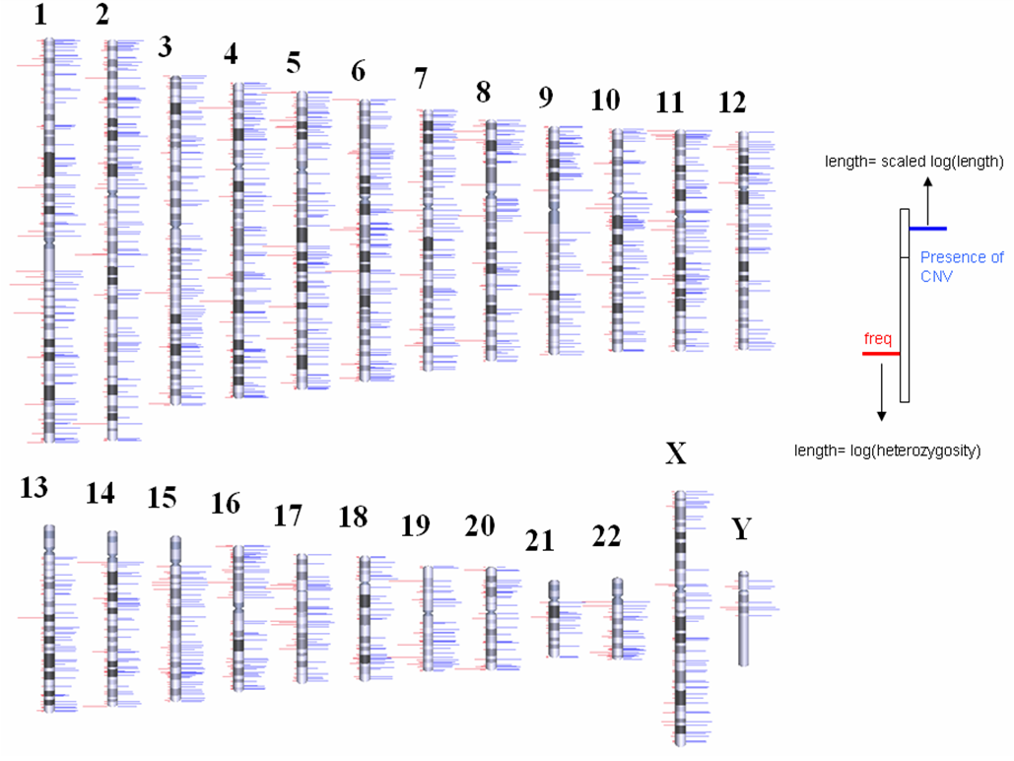
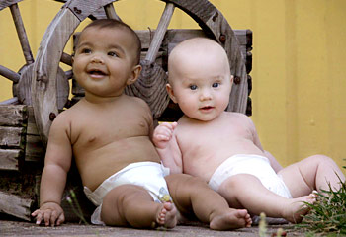
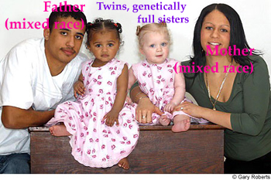
NO, they aren’t- Copy Number Variation (CNV)
changes all that

Slide 13
BEYOND THE GENOME…
OME SWEET OME

Slide 14
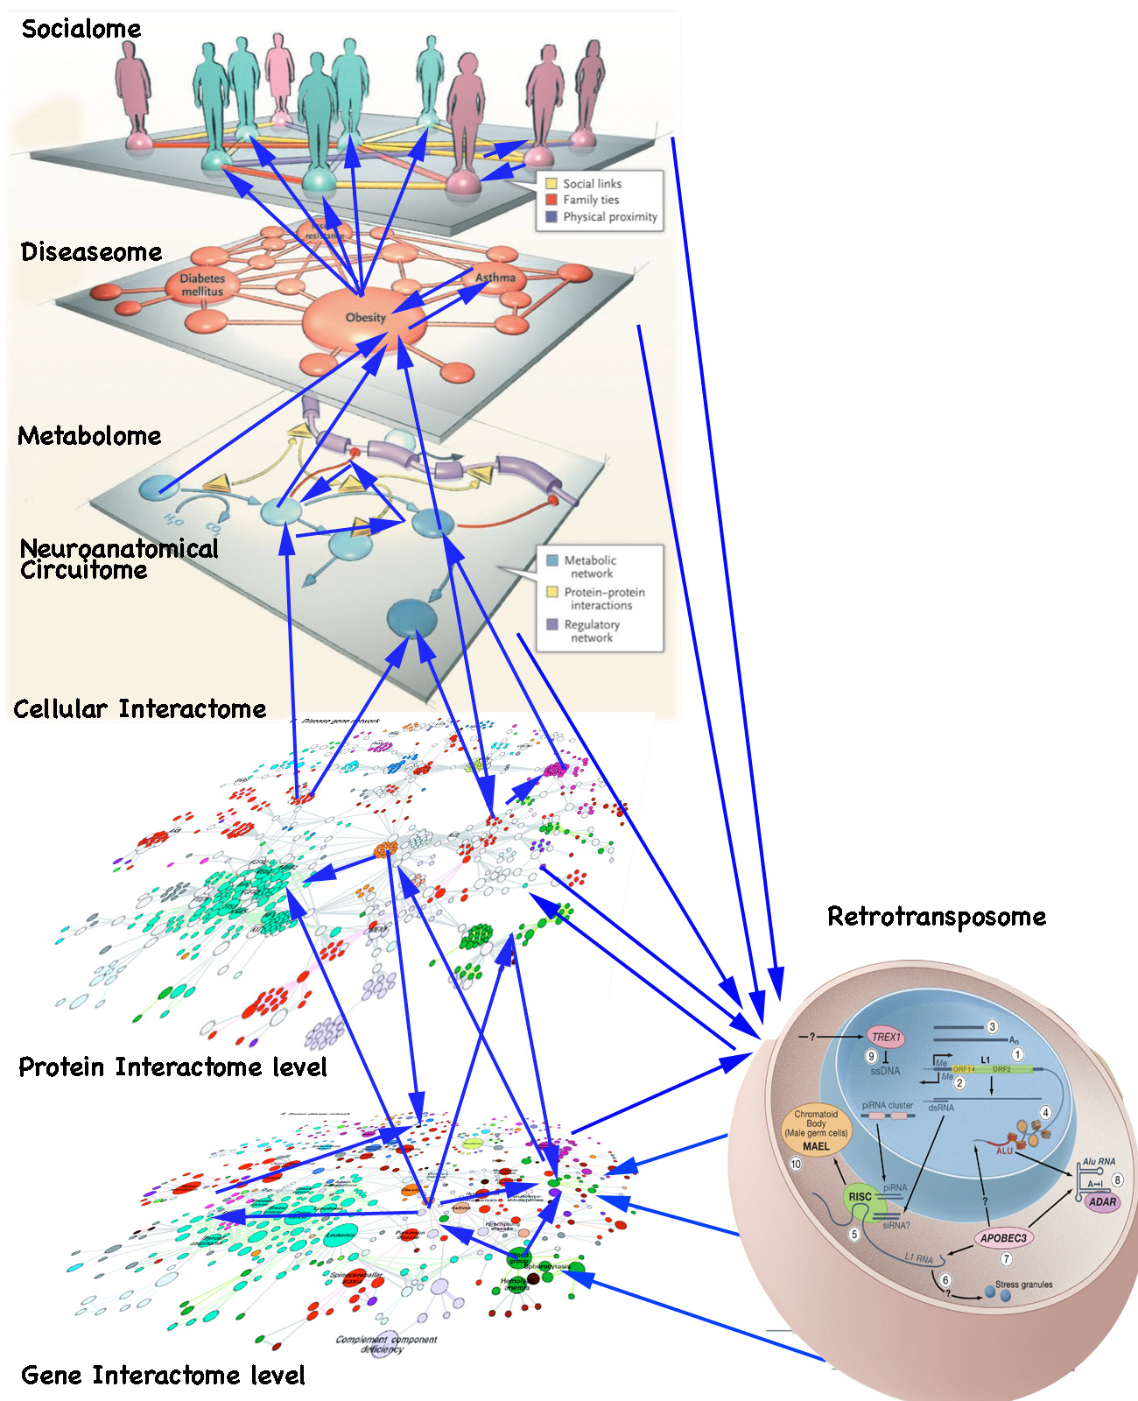
SOCIALOME
DISEASEOME
METABOLOME
CONNECTOME
CELLULAR
INTERACTOME
PROTEIN
INTERACTOME
TRANSCRIPTOME
EPIGENOME
RETROTRANSPOSOSOME
GENOME
MICROBIOME

Slide 15
DIAGNOSIS

Slide 16
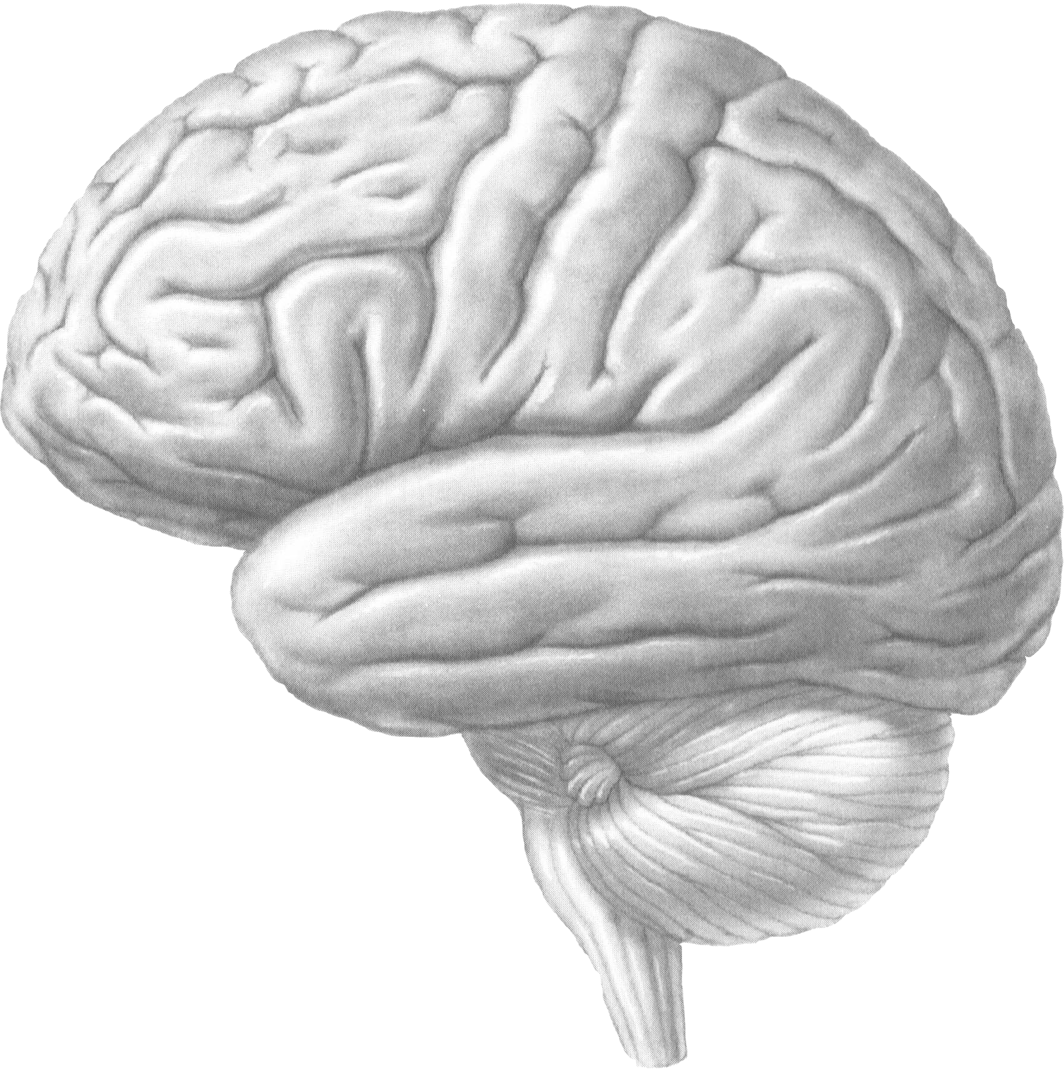
Connectome correlates of psychopathy-
What is the name of the beast?
CONNECTOME
BEHAVIORS
DISORDER

Slide 17
Connectome correlates of psychopathy-
What is the name of the beast?
CONNECTOME
BEHAVIORS
“Psychopath,”
but there is no
such DSM beast
DISORDER

Slide 18
The DSM has a diagnosis of Antisocial Personality
Disorder (ASPD), which states: "The essential feature of
antisocial personality disorder is a pervasive pattern of
disregard for, and violation of, the rights of others that
begins in childhood or early adolescence
and continues into adulthood”

Slide 19
The DSM has a diagnosis of Antisocial Personality
Disorder (ASPD), which states: "The essential feature of
antisocial personality disorder is a pervasive pattern of
disregard for, and violation of, the rights of others that
begins in childhood or early adolescence
and continues into adulthood”
Not everyone agrees there is such
a distinct entity categorically called
“Psychopath,” but everyone agrees
on the existence of the traits themselves

Slide 20
The DSM has a diagnosis of Antisocial Personality
Disorder (ASPD), which states: "The essential feature of
antisocial personality disorder is a pervasive pattern of
disregard for, and violation of, the rights of others that
begins in childhood or early adolescence
and continues into adulthood”
Psychopathy
Factor 1
Factor 2
Aggressive
Narcissism
Impulsivity
Fearless
Dominance
Criminality
Antisocial
Prosocial

Slide 21
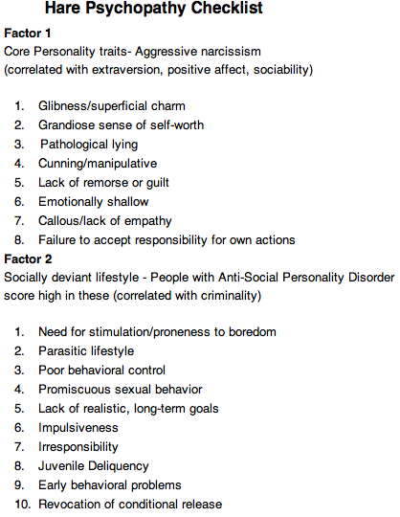
CRIMINAL
POPULATION
FACTOR 1
FACTOR 2

Slide 22
More useful for
the normal
population
Psychopathic Personality Inventory (PPI)- not necessarily criminal or aspd- asps based on behavioral patterns vs personality/character traits. Psychopathic Personality Inventory: Factors and Subscales
PPI–1: Fearless dominance
Social influence
Fearlessness
Stress immunity
PPI–2: Impulsive Antisociality
Machiavellian egocentricity
Rebellious nonconformity
Blame externalization
Carefree nonplanfulness
Also Coldheartedness
Theodore Roosevelt (1.462)
John F. Kennedy (1.408)
Franklin D. Roosevelt (1.079)
Ronald Reagan (.912)

Slide 23
FROM CATEGORICAL DIAGNOSES
TO DIMENSIONALITY OF TRAITS
Person A
Person B
Person C
Low risk
allele
High risk
allele
Low risk
allele
High risk
allele
Low risk
allele
High risk
allele
Serotonin
Transporter
Long
Serotonin
Transporter
Short
Serotonin
Transporter
Long
Serotonin
Transporter
Short
Serotonin
Transporter
Long
Serotonin
Transporter
Short
MAO-A
High active
MAO-A
Low active
MAO-A
High active
MAO-A
Low active
MAO-A
High active
MAO-A
Low active
COMT
High active
COMT
Low active
COMT
High active
COMT
Low active
COMT
High active
COMT
Low active

Slide 24
Psychopathy as a spectrum? That is, a qualitatively
distinct “categorical” disorder, Or just a summed set of
“quantitative traits”(QT)?
Fully Dimensional- anti-social personality traits may be
distributed in the normal population, but does the “psychopathic killer” merely have the highest range of these traits, as opposed to being qualitatively
different than “normals” or “supernormals,” or are they
really qualitatively different (something that public policy makers and the legal system may not want at all)
PSYCHOPATHY RANGE
Supernormal (mensch)
Normal
Successful
Psychopath
Unsuccessful/Full
Blown Psychopath
or
Severe Epigenetic
Developmental
Brain Damage
Abuse

Slide 25
Psychopathy is present with about the same
incidence of 1% in all cultures
But also CONTEXT DEPENDENCE
Therefore there MUST be something useful
about having psychopaths in our midst,
(FOR BREAKOUT SESSION 2)

Slide 26
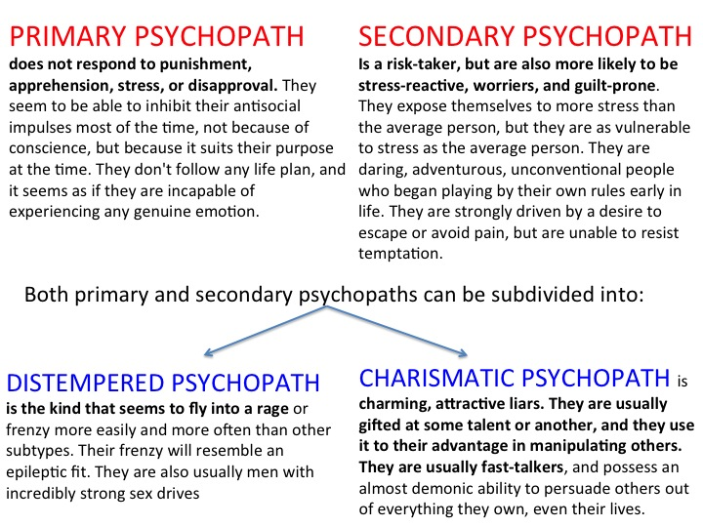

Slide 27
“PSYCHOPATH”
“SOCIOPATH”

Slide 28
CONNECTOMES
(Brain Circuits
implicated in psychopathy)

Slide 29
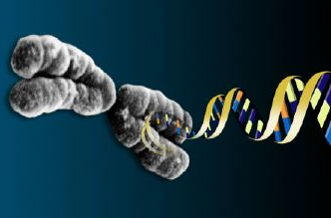
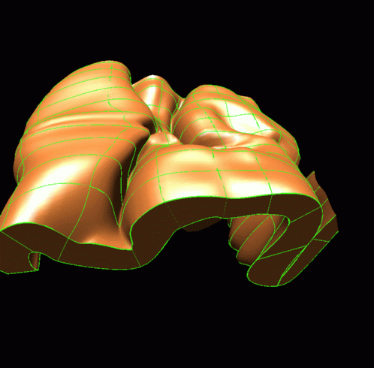
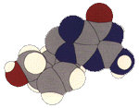
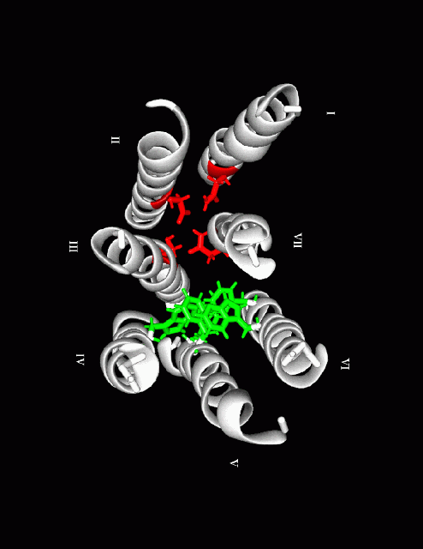
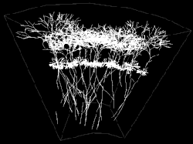
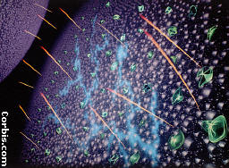
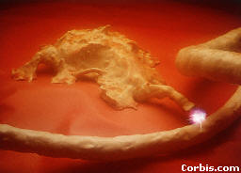
GENOME
Messenger
EPIGENOME
CONNECTOME 3
CONNECTOME 2
TRANSCRIPTOME
BEHAVIORS
DISORDER
CONNECTOME 1
PROTEOME
CONNECTOME

Slide 30
CONNECTOME correlates of psychopathy-
CONNECTOME
BEHAVIORS
DISORDER

Slide 31
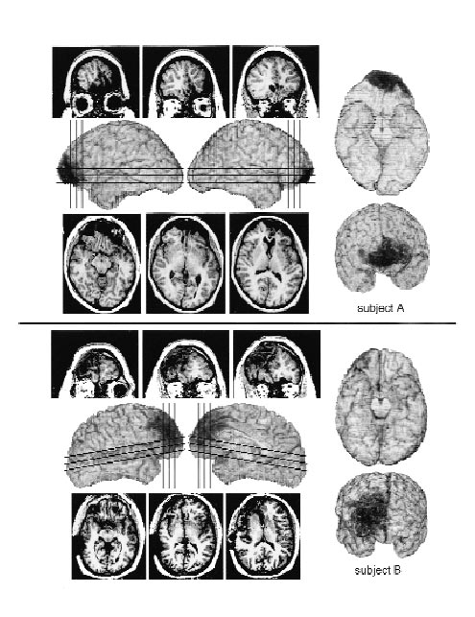
Adult lack of moral
reasoning
Anderson/ Damasio 1999

Slide 32
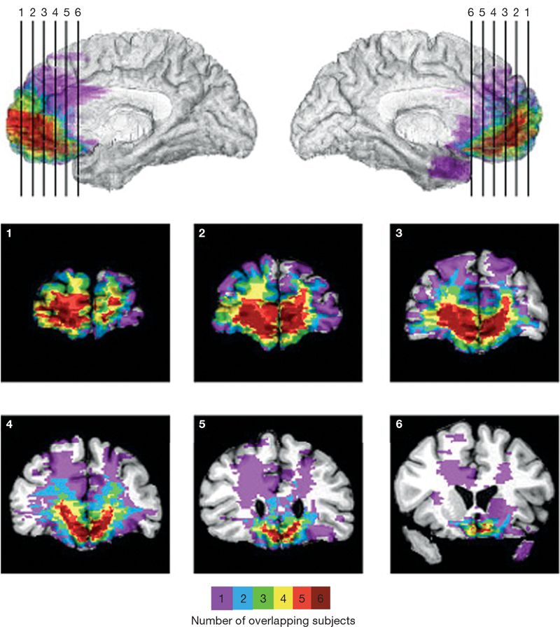
Ventromedial and orbital
prefrontal cortex lesions
and moral judgment
“abnormally 'utilitarian' pattern of judgments on moral dilemmas that pit compelling
considerations of aggregate welfare against highly emotionally aversive behaviors
(for example, having to sacrifice one person's life to save a number of other lives)”
Koenigs et al 2008 Nature
See also Blair 2008

Slide 33
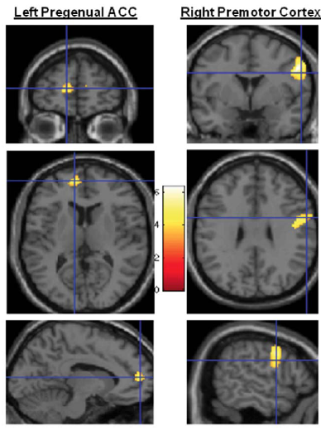
Decreased premotor
cortex volume in
victims of urban
violence with PTSD.
Rocha- Rego et al 2012
Volume reduction in the
premotor cortex that is
observed in victims of urban
violence with PTSD may be
associated with a disruption
in the dynamical modulation of
the safe space around
the body. events.
Notes:
The finding that PTSD patients presented a smaller
volume of pregenual anterior cingulate cortex is consistent with
the results of other PTSD neuroimaging studies that investigated
different types of traumatic

Slide 34
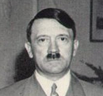
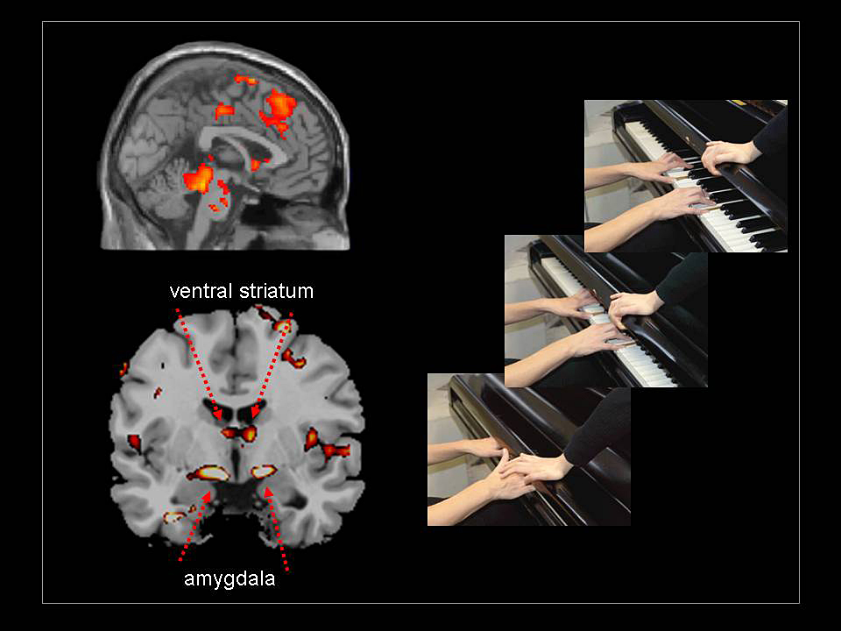
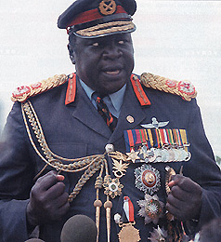
Bullies and Sadism
Jean Decety

Slide 35
DICTATORS- potentially important brain regions

Slide 36
Canonical psychopathic pattern:
The pattern in all
psychopaths tested

Slide 37
Underactive areas of the psychopath brain
CINGULATE
CORTEX
MEDIAL PREFRONTAL CORTEX
ORBITAL
CORTEX
INSULA
AMYGDALA
PARAHIIPOCAMPAL
Also called the “LIMBIC LOBE” also part of SOCIAL BRAIN

Slide 38
KEY EPOCHS OF
BRAIN DEVELOPMENT

Slide 39
Onset of adaptive behaviors in infants and children
Onset in months Behavior
0 Exhibits walking reflex when held upright
0 Exercises all human facial expressions
0 Distinguishes mother’s breast by smell
0 Stage 1 fear to stimuli and physical support changes
0 Reflexive turning to sound
0.5 Loss of reflexive turning
0.75 Loss of walking reflex
1 Coos
1.25 Social smile
2 Laughs
3 Shows handedness preference
3.5 Discriminates mother’s from father’s voice
4.5 Makes raspberry sound
6 Sits alone for 30 sec or more
6 Color perception like adult
7 Loses fear 1, gets fear 2 of strangers, crowds
12 Walks alone
17 7-20 word vocabulary
24 Adult visual acuity
30 Can climb up a tree but not down
30 3 word sentences

Slide 40
CRITICAL PERIODS of brain development
0-3
5-8
9-14
18-21
24-27
33-40
Late 60s
BIRTH
SLOW
GROWTH
PERIOD
PUBERTY
LATE TEENS
FIRST
MATURITY
SECOND
MATURITY
PEAK BRAIN
MATURITY &
PERFORMANCE
DEATH

Slide 41
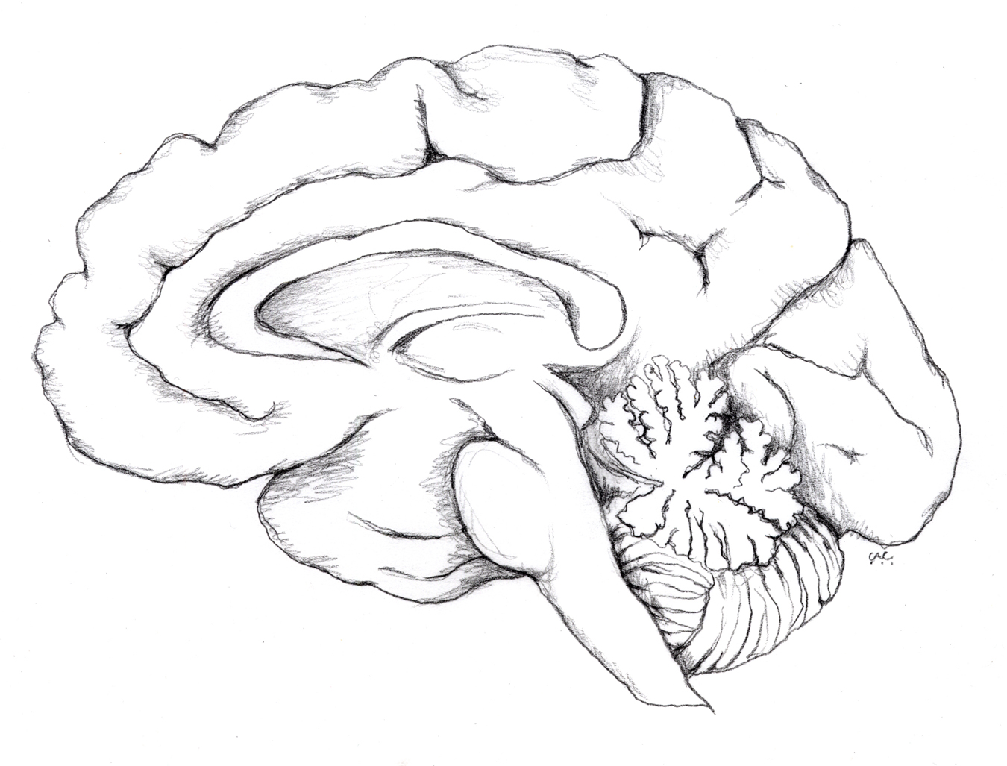
The pre-teenage prefrontal system
COLD COGNITION
HOT COGNITION
Fallon

Slide 42
The maturing (and switching) teenage prefrontal system
COLD COGNITION
HOT COGNITION
Fallon

Slide 43
The mature adult prefrontal system in balance
COLD COGNITION
mens rea?
HOT COGNITION
Fallon

Slide 44
The mature adult prefrontal system in balance
COLD COGNITION
mens rea?
HOT COGNITION
ORBITAL
CORTEX
AMYGDALA
Fallon

Slide 45
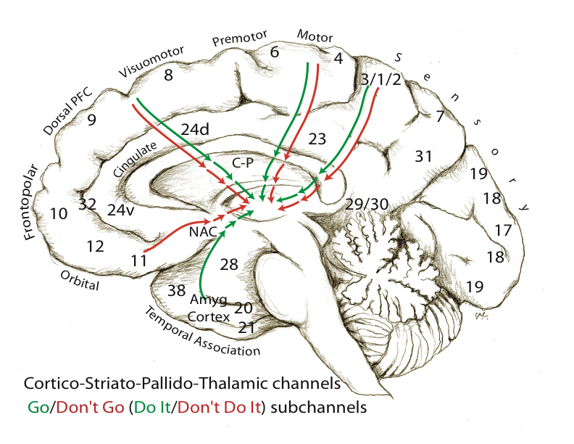
Ventral Stream Areas competing for control of behavior
ACCUMBENS
ORBITAL
CORTEX
AMYGDALA
Fallon et al 2003

Slide 46
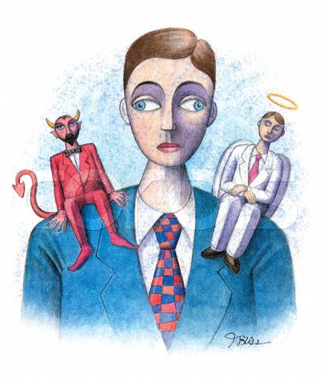
-
-
Amygdala
Orbital
Cortex
CRH
Competition among
prefrontal and limbic
cortices for control
of DA influence
in nucleus accumbens
DA
Nucleus
Accumbens
DA
DO IT!
DON’T DO IT!
Behavior:
Do it or Don’t Do it?

Slide 47
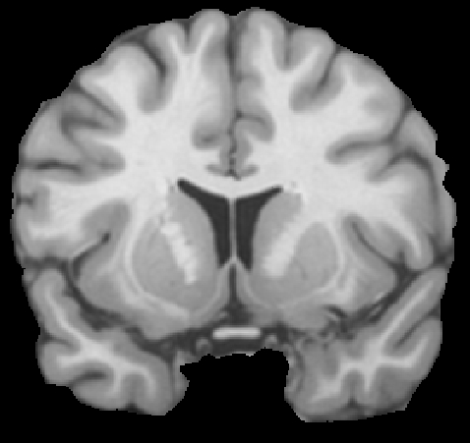
HEDONIC HOT SPOT
Nucleus Accumbens dm
OXYTOCIN Receptor
Septum
VASOPRESSIN Receptor AVPR1a
ANDROGEN Rec.

Slide 48
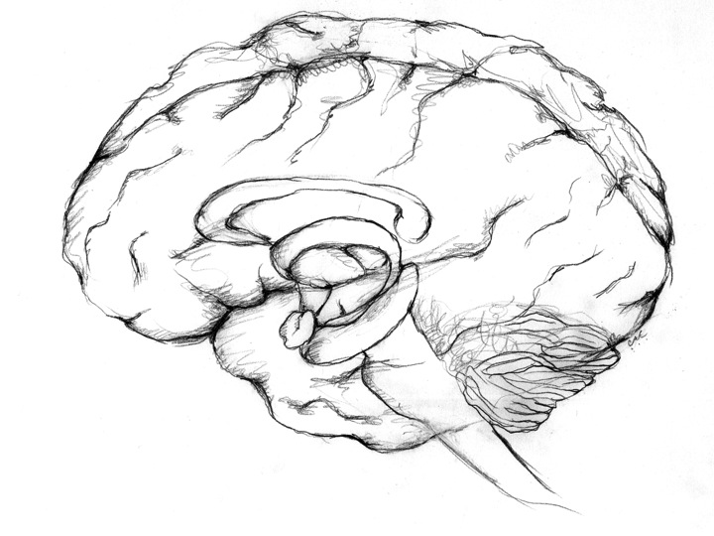
Medial cortex-
inner world
Dorsal prefrontal cortex-
Comparisons, dualities
Lateral cortex-
outside world
Orbital cortex-
ethics, morality
Amygdala, hippocampal cortex-
animal drives, emotions
DUALITIES PERCEIVED BY THE DORSAL PREFRONTAL CORTEX

Slide 49
PSYCHOPATHS DO NOT HAVE A SENSE OF DUALITY
Medial cortex-
inner world
Dorsal prefrontal cortex-
Comparisons, dualities
Lateral cortex-
outside world
Orbital cortex-
ethics, morality
Amygdala, hippocampal cortex-
animal drives, emotions
DUALITIES PERCEIVED BY THE DORSAL PREFRONTAL CORTEX

Slide 50
GENES

Slide 51
General Psychiatric traits and Genetics
GENE Example Effect Some Interactions Positive vs Negative Effect
MAO-A serotonin levels Early abuse Abuse inc aggression
Serotonin Early environment Abuse-Psychopathy
Transporter SERT affects aggression Love- Offsets aggression
Oxytocin Affects bonding Self vs Other/Group Focus Self- inc. interpersonal bond
Group- increase lying for group
Unequal $$$ gains Inc. envy, schadenfreude
COMT Dopamine levels PFC val-val WARRIOR less efficient PFC
met-met WORRIER more efficient PFC
BDNF Memory and Anxiety normal val66met- inc memory, inc anxiety
val-val dec anxiety, dec memory
stress childhood- met stronger effect
teen, adult- opposite
gender x BDNF val female- inc limbic connectivity

Slide 52
Psychopathic traits and Genetics
MAOA-L (“warrior gene”)
“High Risk” serotonin transporter
NE transporter
TH [TPH1,2]
Androgen receptor
DAGK1
DBH
COMT
NOS1
+ low emotional empathy alleles- NEXT
Aggression
and violence

Slide 53
Empathy, altruism genetics
Oxytocin receptor OXTR G more empathetic than A
Testosterone receptor more T, less generous
Vasopressin receptor AVPR1A
GABA GABRB3 empathy variance
Dopamine DRD4, DRD5 KIN VS NON KIN caring altruism
IGF2
COMT
OXY related CD38
CRF GRIN1 cortisol

Slide 54
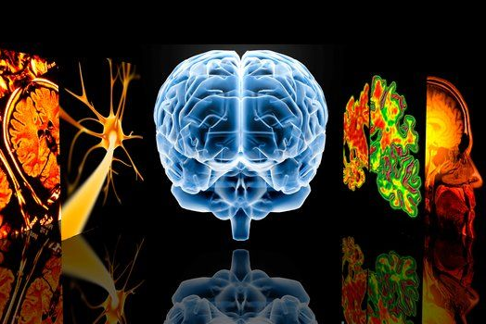
Transmitter Summary
Low Levels
Norepineprine (NE)
Serotonin (5-HT)
GABA
MAO
High Levels
Dopamine (DA)
Glutamate
Leads to sensitivity to reward mechanisms, sensation-seeking behavior, and the tendency to express oneself more aggressively.
SASHA REID
Notes:
Background Citation: http://www.sciencephoto.com/media/137939/enlarge
Information Citation:
Moll, J., De Oliveira-Souza, R., Zahn, R. (2008). The Neural Basis of Moral Cognition: sentiments, concepts, and values. Annals of the New York Academy of Sciences, 1124 (1).
54

Slide 55
EPIGENETICS

Slide 56
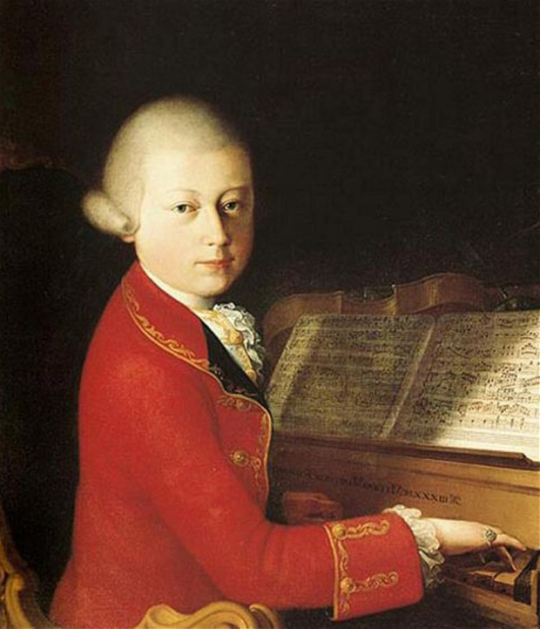

Slide 57
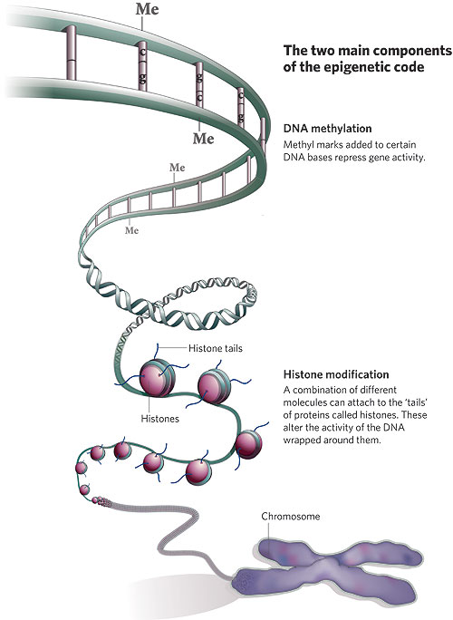
EPIGENETIC
EFFECTS
EXTREME STRESS
COCAINE
EARLY TRAUMA
MATERNAL BEHAV
TOXINS
ABANDONMENT
FOODS
DNA
METHYLATION
HISTONE
MODIFICATION
GENES

Slide 58
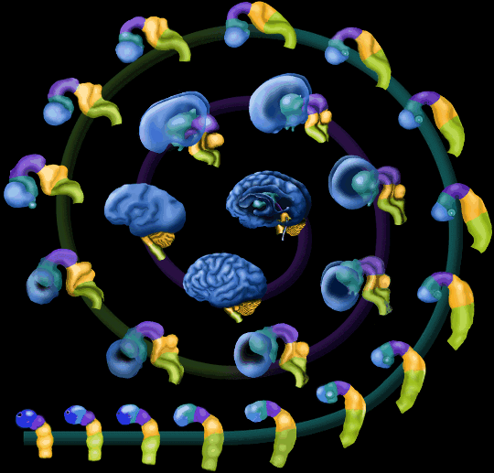
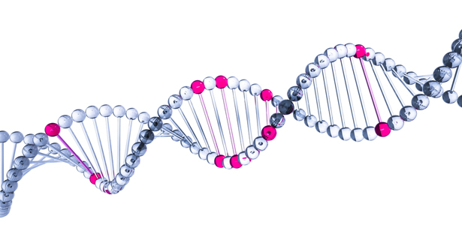
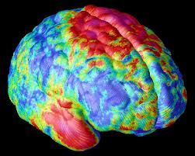
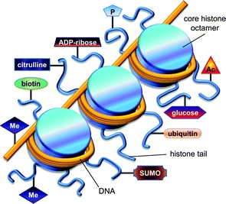
Brain Development
Normal
Brain Development Disorder
Genetic Mutation
SCHIZOPHRENIA
Epigenetic modifications
AUTISM

Slide 59
TYPES OF EPIGENETIC EFFECTS
INTRAGENERATIONAL
(personal)

Slide 60
EPIGENETICS
Brunner 1993 missense of MAO-A
in one family

Slide 61
MAO-A ; The first “warrior gene”
A Dutch kindred with a missense mutation in the MAO-A gene
was described : hemizygous males, representing functional
gene knockouts, exhibited impulsively violent criminal
behavior for generations (Brunner et al 1993)
There is one major group of single
nucleotide polymorphisms (SNPs) in the
MAO-A gene; A combination in one
group results is low MAO-A activity
and high serotonin levels
and is associated with High Risk
for violence and aggression

Slide 62
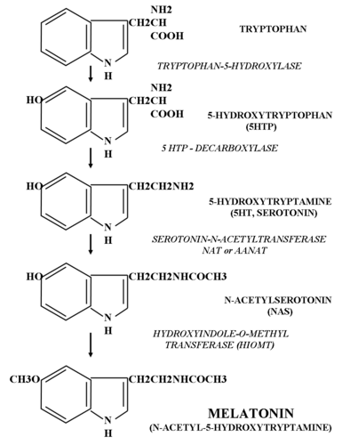
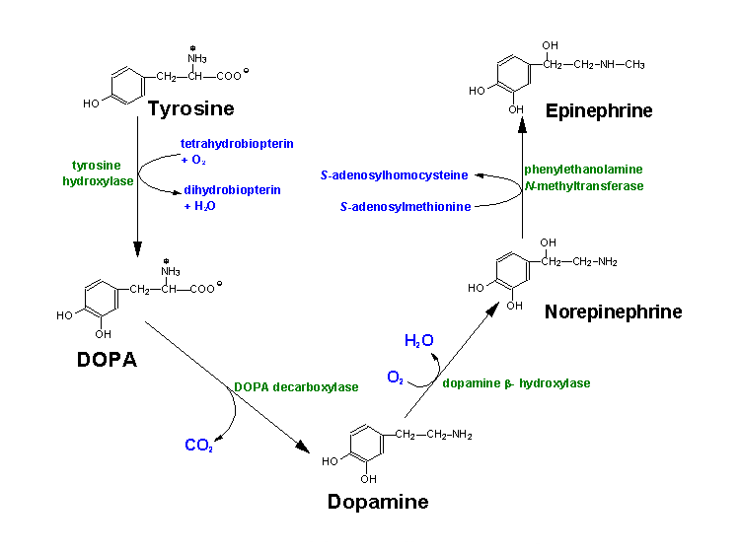
The MAO-A enzyme breaks down serotonin
SEROTONIN
DOPAMINE
MAO-A,
MAO-B
COMT
(frontal cortex)
MAO-A
Notes:
Catechol-O-methyl transferase is involved in the breakdown of the catecholamine neurotransmitters, dopamine, epinephrine and norepinephrine. The enzyme introduces a methyl group to the catecholamine which is donated by S-adenosyl methionine (SAM).
A functional polymorphism (a common normal variant) of the gene for catechol-O-methyl transferase has been shown to affect cognitive tasks broadly related to executive function, such as set shifting, response inhibition, abstract thought and the acquisition of rules or task structure.
The link between impairments in these sorts of cognitive tasks and the COMT gene is thought to be mediated by an effect on dopamine signalling in the frontal lobes.
Arguably, the clearest link between genetic variation and aggression exists for Monoamine Oxidase A (MAO-A, MIM 309850), a key enzyme in the catabolism of monoamines, especially serotonin. The serotonergic system has been implicated in impulsivity and manifest violent behaviour in animals and both auto- and heteroaggression in humans . MAO A and B genes, likely derived from the same ancestral gene, are both located on the X-chromosome (Xp11.23), comprising 15 exons with identical intron-exon organization . MAO-A provides the major enzymatic clearing step for serotonin and norepinephrine during brain development, while MAO-B activity increases dramatically after birth . Mouse knockouts for MAO-A, but not MAO-B, have elevated brain levels of serotonin, norepinephrine, and dopamine. They show enhanced amygdala-dependent emotional, but not motor, learning , and males exhibit dramatically increased aggressive behaviour . In humans, a Dutch kindred with a missense mutation in the MAO-A gene was described : hemizygous males, representing functional gene knockouts, exhibited a pattern of impulsively violent criminal behaviour for generations.

Slide 63
EPIGENETICS
2) Caspi (2002) the first demonstration
of nature-nurture interaction

Slide 64
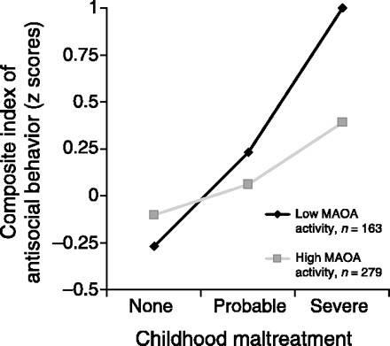
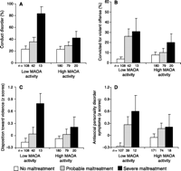
3
ENVIRONMENT
VIOLENCE RELATED
CANDIDATE GENE
eg MAOA-L
GENES
EPIGENOME
TIMING
Caspi (2002) found that the high risk genotype (ie low levels of MAO-A; high levels of
serotonin) affects responses to harsh environmental stressors. The genetically
high risk individuals who were also maltreated as children were much more
likely to develop antisocial personality disorder, and convicted for violent crimes.
Low MAO-A
(high serotonin
high risk)
*
High MAO-A
(low serotonin,
low risk)

Slide 65
TYPES OF EPIGENETIC EFFECTS
INTRAGENERATIONAL
(personal)
TRANSGENERATIONAL

Slide 66
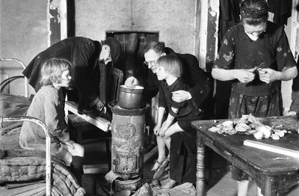
TRANSGENERATIONAL EPIGENETIC EFFECTS

Slide 67
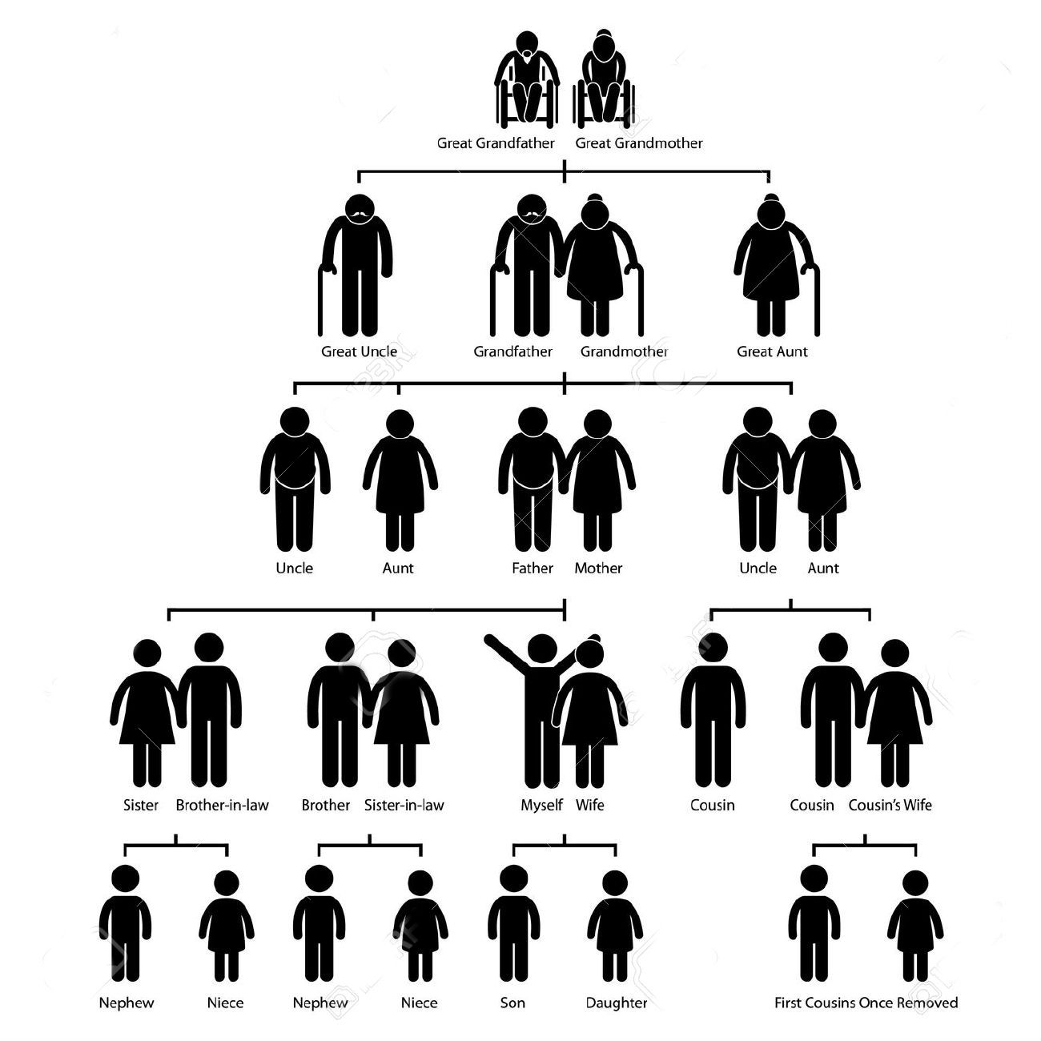
TRANSGENERATIONAL EPIGENETICS
FEAST OR FAMINE- THE SWEDISH
GRANDFATHER FEASTED
IN PRE-PUBERTY WHEN
SPERM ARE MATURING
1905 SWEDISH FAMINE
PATERNAL LINE
GRANDSONS DIE 32
YEARS EARLIER, OFTEN
OF DIABETES, THAN
GRANDSONS WHOSE
GRANDFATHERS WHO
WERE STARVED

Slide 68
TRANSGENERATIONAL EPIGENETICS
FEAST OR FAMINE- FOLLOW-UP BRITISH/SWEDISH STUDY
GRANDMOTHER STARVATION
WHEN THEY WERE IN THE
WOMB
MATERNAL LINE
GRANDDAUGHTERS
DIE EARLIER THAN
GRANDDAUGHTERS
WHOSE GRANDMOTHERS
MOTHERS HAD
FEASTED

Slide 69
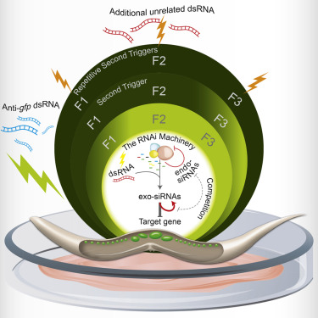
TRANSGENERATIONAL EPIGENETICS MECHANISMS
RNAi interference- small RNAs erasing
‘memory’ of epigenetic marks
dsRNA- double stranded RNA splices
dsRNA-induced RNAi affects the
production of heritable endogenous
small RNAs, which regulate the
expression of RNAi factors, thus
This feedback can regulate the
duration of the heredity
A Tunable Mechanism Determines the Duration of the
Transgenerational Small RNA Inheritance. Cell
Houri-Ze’evi et al March 2016

Slide 70
CAN ‘PERMANENT’ EPIGENETIC
MARKS eg in psychopathy, BE REVERSED?
Epigenetic Reprogramming
Brami-Cherrier, Macciardi,
Borelli et al 2014

Slide 71
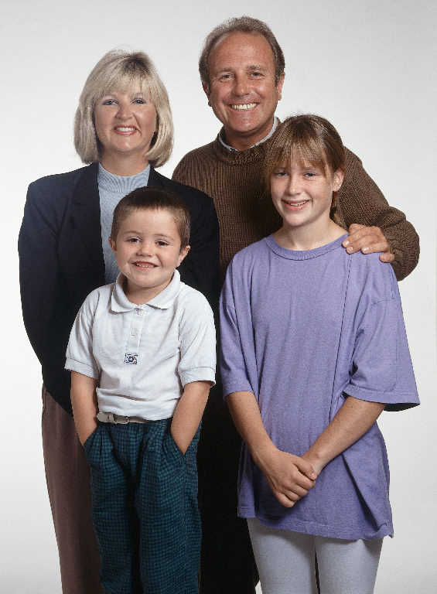
THE MAO-A IS LOCATED ON THE X CHROMOSOME SO IF THE MOTHER PASSES THE HIGH RISK ALLELE TO THE SON HE IS AT RISK- CHANCES ARE THAT DAUGHTERS WON’T BE AT RISK
XX
XY
XX
XY
XX
XY
XX or XX
NOT AT RISK
XX or XX
XX at RISK
XY
AT RISK
XY
AT RISK

Slide 72
Genomics vs. Genetics
Genetics: study of inherited phenotypes
Peter Goodfellow (1997, Nature Genetics 16:209-210): "...I would define genetics as the study of inheritance and genomics as the study of genomes. The latter informs the former and includes the sequencing of genomes. The concept of functional genetics is a tautology (the whole point of genetics is to link genes with phenotypes). Functional genomics is the attachment of information about function to knowledge of DNA sequence' paradoxically, genetics is a major tool for functional genomics."

Slide 73
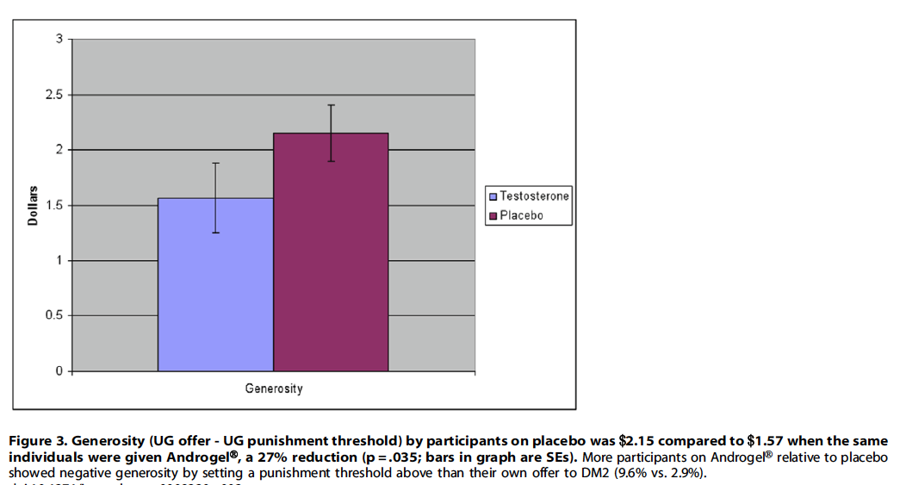
TESTOSTERONE AND ITS
ANDROGEN RECEPTOR

Slide 74
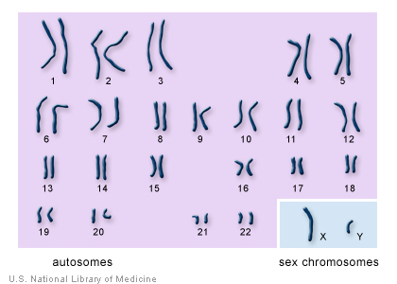
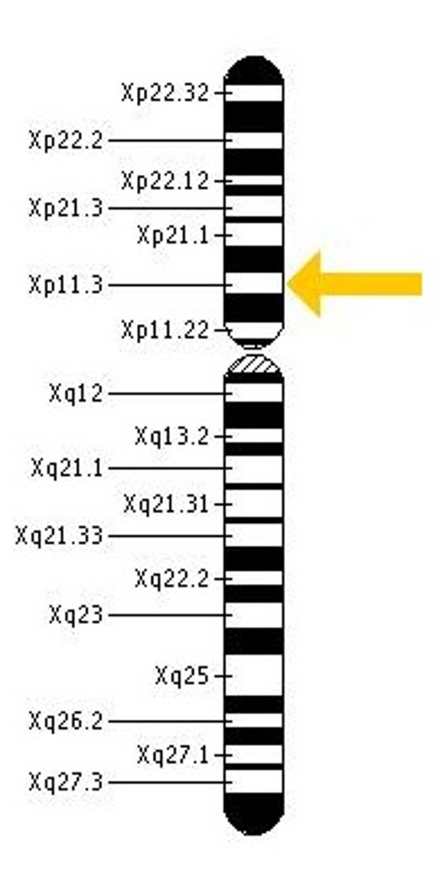
X CHROMOSOME
MAOA
GENE
X
The MAO-A is coded for
on the X chromosome
JIM
SUBJECT A
SUBJECT B
SUBJECT C
SUBJECT D

Slide 75
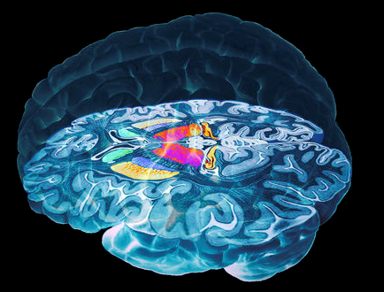
Structural Features
Anterior Cingulate
(Glenn & Raine, 2008)
Closely connected with the amygdala.
Reduced functioning during fear conditioning.
Reduced functioning in processing of emotional information.
Angular Gyrus
(Glenn & Raine, 2008)
Deficits in this region during semantic processing tasks.
Involved in experiencing emotion.
Insula
(Glenn & Raine, 2008)
Reduced functioning during fear conditioning.
Involved in emotional processing of anticipatory
anxiety and associated body states.
Amygdala
(Glenn & Raine, 2008)
Involved in emotional processing.
Orbitofrontal Cortex (OFC)
(Glenn & Raine, 2008).
Receives emotional input from the amygdala.
if connectivity between the amygdala and OFC is disrupted,
the OFC will be unable to form representations and feelings such as
anticipatory fear of aversive events will not be generated.
Notes:
Background Citation: http://www.sciencephoto.com/image/306610/530wm/P3300438-Basal_ganglia_of_the_brain,_3-D_MRI_scan-SPL.jpg
Information Citation:
Glenn, A. L., & Raine, A. (2008). The Neurobiology of Psychopathy. Psychiatric Clinics of North America, 31, 463-475.
75

Slide 76
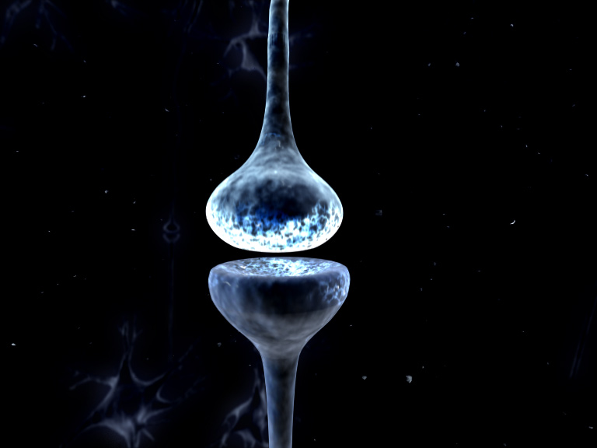
Serotonin (5-HT)
Dopamine (DA)
Plays an important role in the
modulation of behaviour.
Related to immediate reward
focus and motivated behaviour.
(Schneider & Nussbaum, 2007)
e.g. aggression and impulsivity
(Moll, De Oliveira-Souza, & Zahn, 2008)
An increase of dopamine in the
nucleus accumbens stimulates
appetitive, impulsive and
aggressive behaviours.
Low levels of 5-HT have
consistently been related to
impulsivity, antisociality, &
aggression.
(Fallon, 2006)
(Moll, De Oliveira-Souza, & Zahn, 2008)
5-HT is responsible for
inhibiting dopaminergic
reward focus, but
psychopaths have low levels
of 5-HT coupled with...
High levels of DA, which
overwhelms the 5-HT inhibitory
system leading to aggressive
behaviour.
(Fallon, 2006)
(Moll, De Oliveira-Souza, & Zahn, 2008)
DA
Psychopaths have
5-HT
Notes:
Background Picture Citation: http://philosophyandpolity.files.wordpress.com/2011/04/synapse.jpg
Serotonin Citation:
Moll, J., De Oliveira-Souza, R., Zahn, R. (2008). The Neural Basis of Moral Cognition: sentiments, concepts, and values. Annals of the New York Academy of Sciences, 1124 (1).
Dopamine Citation:
Schneider, D., & Nussbaum, D. (2007). Can the mad be bad?. The Criminal Law Quarterly, 53. 206-226.
Fallon, H. J. (2006). Neuroanatomical Background to Understanding the Brain of the Young Psychopath. Ohio State Journal of Criminal Law, 3 (341). 341-367.
76

Slide 77
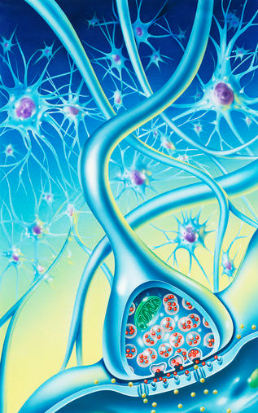
GABA
gamma-amino butyric acid
A major inhibitory neurotransmitter.
e.g. curbs impulsive decision-making
(Nussbaum et al., 2010)
GABA functions in performance monitoring
and curbs impulsive behaviour.
(Nussbaum et al., 2010)
Low levels of GABA in brain areas including
the striatum and the olfactory bulbs have
been observed in humans and mice that
display aggressive behaviour.
(Clement et al., 1987)
GABA is modulated by 5-HT in corticolimbic
neurons.
(Da Almedia, Ferrari, Parmigiani, & Miczek, 2005)
Notes:
Background Citation: http://www.sciencephoto.com/media/307730/enlarge
GABA Citations:
Clement, J., Simler, S., Ciesielski, L., Mandel, P., Cabib, S., Puglisi-Allegra, S. (1987). Age-dependent changes of brain GABA levels, turnover rates and shock-induced aggressive behavior in inbred strains of mice. Pharmacology of Biochemical Behaviour, 26, 83–88.
De Almeida, M. R., Ferrari, F. P., Parmigiani, S., and Miczek, K. A. (2005). Escalated aggressive behavior: Dopamine, serotonin and GABA. European Journal of Pharmacology, 526, 51–64.
Nussbaum, David., Honarmand, K., Govoni, R., Kalahani-Bargis, M., Bass, S., Ni, X., LaForge, K., Burden A., Romero, K., Basarke, S., Courbasson, C., & Deamond, W. (2010). An Eight Component Decision-Making Model for Problem Gambling: A Systems Approach to Stimulate Integrative Research. Journal of Gambling Studies.
77

Slide 78
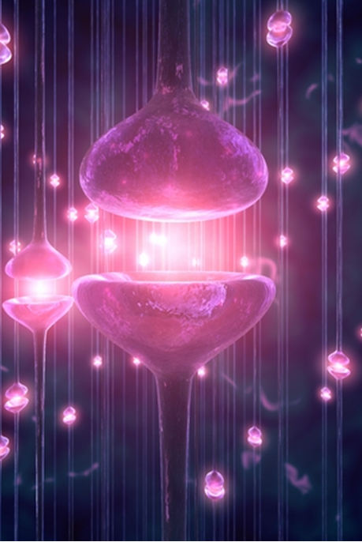
GLUTAMATE
Major excitatory neurotransmitter.
(Nelson, 2005)
Implicated in associative learning
and reward.
(Navarro, de Castro, & Martin-Lopez, 2009)
Is involved in the regulation of aggressive
behaviour.
(Nelson, 2005)
Modulates DA activity in the VTA-
NAcc pathway.
e.g. Impacts the reward focused
effect of DA on decision-
making.
(Nussbaum et al., 2010)
Too little glial glutamate results in
excessive synaptic glutamate release
which strongly enhances NAcc DA release
and a bias toward decision making
favouring immediate gratification.
(Nussbaum et al., 2010)
Notes:
Background Citation: http://www.guidenseek.com/synapse-care.html
Glutamate Citation:
Navarro, J. F., de Castro, V., and Martín-López, M. (2009). Behavioural profile of selective ligands for mGlu7 and mGlu8 glutamate receptors in agonistic encounters between mice. Psicothema, 21 (3), 475-479.
Nelson, R. J. (2005). Biology of Aggression. Oxford University Press.
Nussbaum, David., Honarmand, K., Govoni, R., Kalahani-Bargis, M., Bass, S., Ni, X., LaForge, K., Burden A., Romero, K., Basarke, S., Courbasson, C., & Deamond, W. (2010). An Eight Component Decision-Making Model for Problem Gambling: A Systems Approach to Stimulate Integrative Research. Journal of Gambling Studies.
78

Slide 79
Transmitter Summary
Low Levels
Norepineprine (NE)
Serotonin (5-HT)
GABA
MAO
High Levels
Dopamine (DA)
Glutamate
Leads to sensitivity to reward mechanisms, sensation-seeking behavior, and the tendency to express oneself more aggressively.
SASHA REID 2013
Notes:
Background Citation: http://www.sciencephoto.com/media/137939/enlarge
Information Citation:
Moll, J., De Oliveira-Souza, R., Zahn, R. (2008). The Neural Basis of Moral Cognition: sentiments, concepts, and values. Annals of the New York Academy of Sciences, 1124 (1).
79

Slide 80
