Slide 1
Utilizing Communication Styles when working with At-risk Yuth
Fabian Ramirez, M.A.

Slide 2
Utilizing Communication Styles when working with At-risk Yuth
Fabian Ramirez, M.A.

Slide 3
What to Expect
Reminders: same information at a different season
New information
Common language (helps you categorize experiences and communicate feelings/concerns in a productive way)

Slide 4
DISC Overview
Tasks | Big Picture (Forest) |  | People
 | D | I
 | C | S
 | Details (Trees)

Slide 5
DISC Overview: Characteristics
Tasks | Big Picture (Forest) |  | People
 | D Dominating, Direct, driving, demanding, determined, decisive, doers Basic Motivation: Challenge/Control | I Inspiring, influencing, inducing, impressing, interactive, interested in people Basic Motivation: Recognition/Approval
 | C Cautious, competent, calculating, compliant, careful, contemplative Basic Motivation: Quality/Correctness | S Steady, stable, shy, security-oriented, servant, submissive, specialist Basic Motivation: Stability/Support
 | Details (Trees)

Slide 6
DISC Overview: Desires
Tasks | Big Picture (Forest) |  | People
 | D Desires: Freedom from control/authority, varied activities, choices rather than ultimatums | I Desires: Prestige (popularity), freedom from details, chance to verbalize ideas
 | C Desires: Clearly defined tasks, limited risks, Time to think/plan | S Desires: An area of specialization, identification with a group, consistent familiar environments
 | Details (Trees)

Slide 7
Under Pressure
D- demanding, angry, forceful, direct, bossy
D- Want to Attack
I- Hyper, immature, emotional, irrational, silly, selfish
Want to Expose/Blame Others
S- insecure, fearful, weak-willed, withdrawn
Want to Support/Submit
C- Moody, critical, contemplative, negative, worrisome
Want to Criticize

Slide 8
Your Significant Relationships
Best guess at Identifying Profiles of:
Spouse
Students Who Get In Trouble

Slide 9
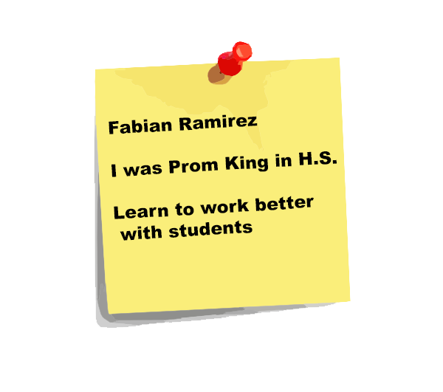
Where would you put yourself?
Tasks | Big Picture (Forest) |  | People
 | D | I
 | C | S
 | Details (Trees)

Slide 10
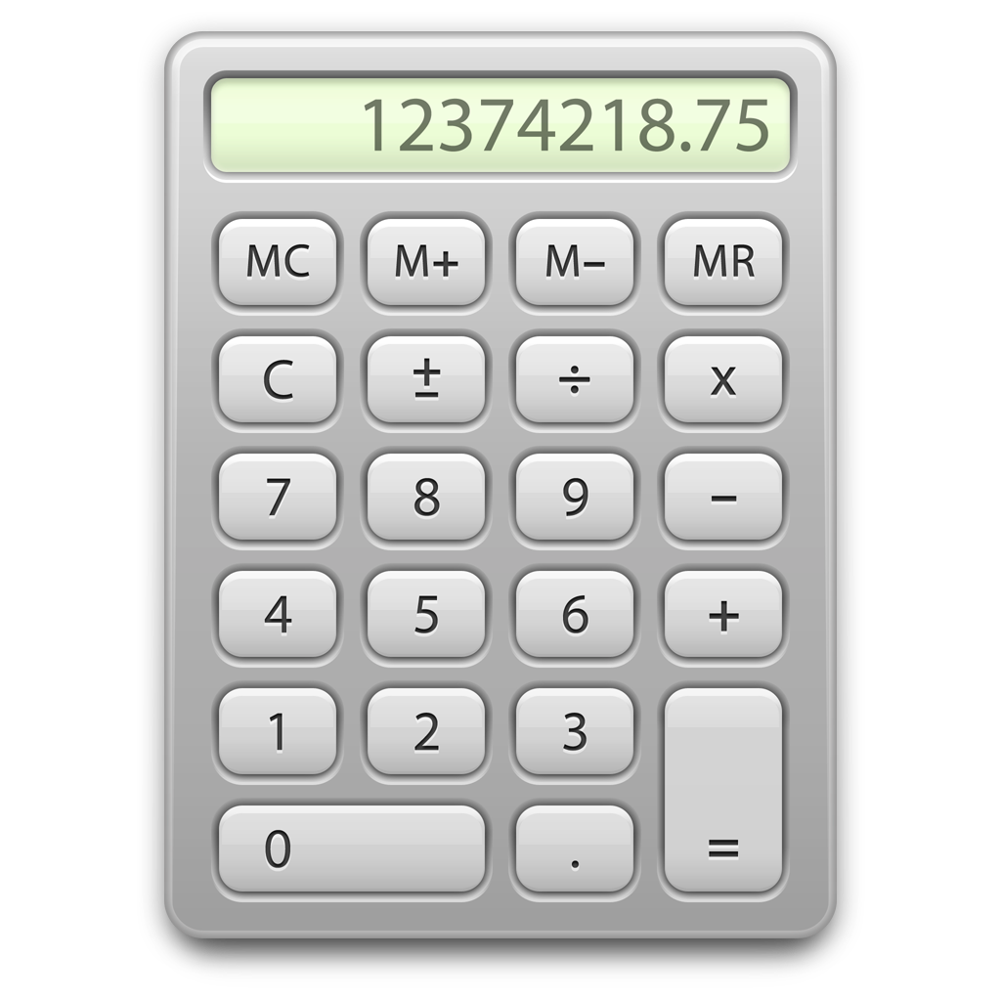
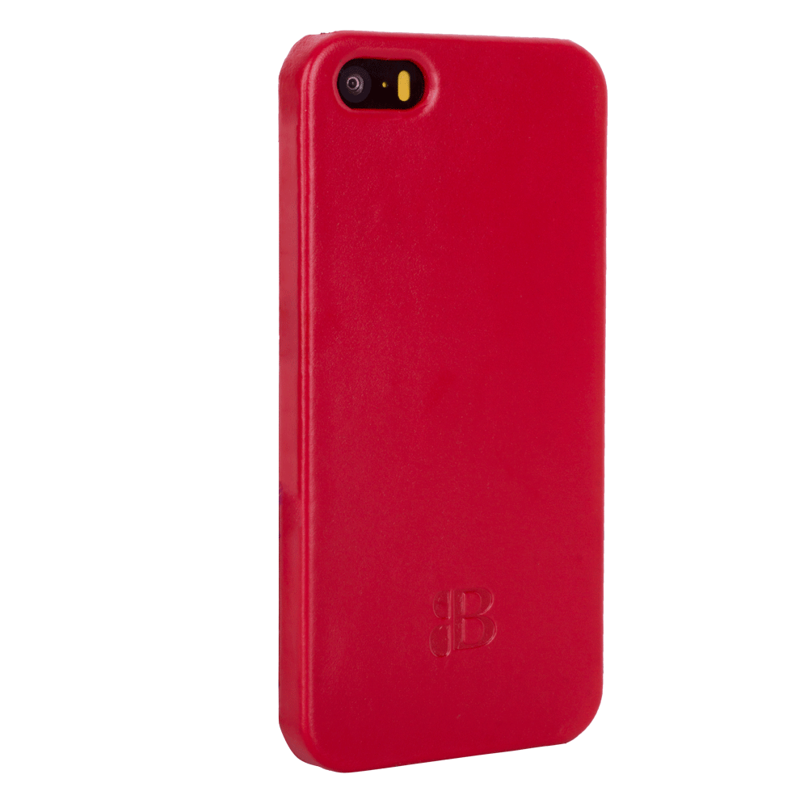
DISC VIsuals
Tasks | Big Picture (Forest) |  | People
 | D | I
 | C | S
 | Details (Trees)

Slide 11
Principles Adults can Instill
D- People Matter
to seek peace, to relax, to think before reacting
I- Accept Responsibility
listen, count the cost, manage emotions
S- Voice Feelings
To be strong, courageous, assertive, expressive, bold
C- People are More Important than Things
More than one way to do something, communicate, positive.

Slide 12
Responds Best to an adult Who:
Tasks | Big Picture (Forest) |  | People
 | D Gets to the point, provides pressure, allows freedom for personal accomplishments | I Provides recognition of abilities, offers rewards for risk-taking
 | C Provides reassurance, invites/listens to suggestions, explains expectations | S Allows time to adjust to changes, allows to work at own pace, gives personal support
 | Details (Trees)

Slide 13
Conflict Resolution
Natural Responses
Effective Responses
D- Want to Attack
I- Want to Expose/Blame Others
S- Want to Support/Submit
C- Want to Criticize
D- Stay focused on purpose of Relationship
I- Make Others Look Good/Accept Responsibility
S- Care Enough to Confront
C- First Examine Self

Slide 14
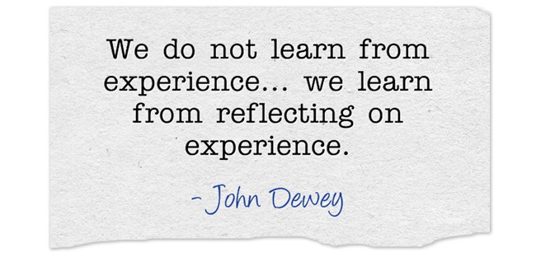
Reflection
What do you think makes your style helpful in your current role?

Slide 15
Handling Different Styles
To be more effective, Youth need to learn…
Opportunities/Messages
D’s-
to identify with a group,
to receive difficult assignments
Adults to D’s-
“You are a special part of our group. We are incomplete without you.”
“I have a challenge, you think you can do it?”
C’s-
to receive specific feedback on performance
to respect people’s personal worth as much as their accomplishments
Adults to C’s-
Get specific
Value qualities in addition to accomplishments

Slide 16
Handling Different Styles
To be more effective, Youth need to learn…
Opportunities/Messages
I’s-
To make priorities and deadlines
To make objective decisions
Adults to I’s-
Help them to make short-term goals/set deadlines
Pros/Cons Process
S’s-
Recognize self-worth
To have creativity encouraged
Adults to S’s
Help them to see what qualities make them unique
Do creative activities together

Slide 17
Questions Youth Ask Themselves
D- What did I do today?
I- Whom did I influence today?
S- Are my surroundings stable?
C- Were the things I did today done correctly?/Am I doing this right?

Slide 18
Youth Pitfalls
D- Will bite off more than they can chew…Or lead others in the wrong direction (gang leader)
I- Can become too social, getting in trouble creates a platform
S- Want to fix everybody’s problems. (Give too much of themselves) Get’s in trouble by association
C- Will get in trouble to impress others. (Often Lack Networking/Social Skills, will calculate risk)

Slide 19
Rewording Questions
D- Is there anything I can do to help you accomplish ____________________? (relate question to task)
I- Ask them anything in front of people (give them a platform).
S- Identify one of their strengths and then ask, “how did you develop that ability?” (often they do not see their strengths as strengths)
C- What would you change about today’s experience? (Give them an opportunity to critique using a positive platform)

Slide 20
Questions about DISC?
How will you use DISC moving forward?

Slide 21
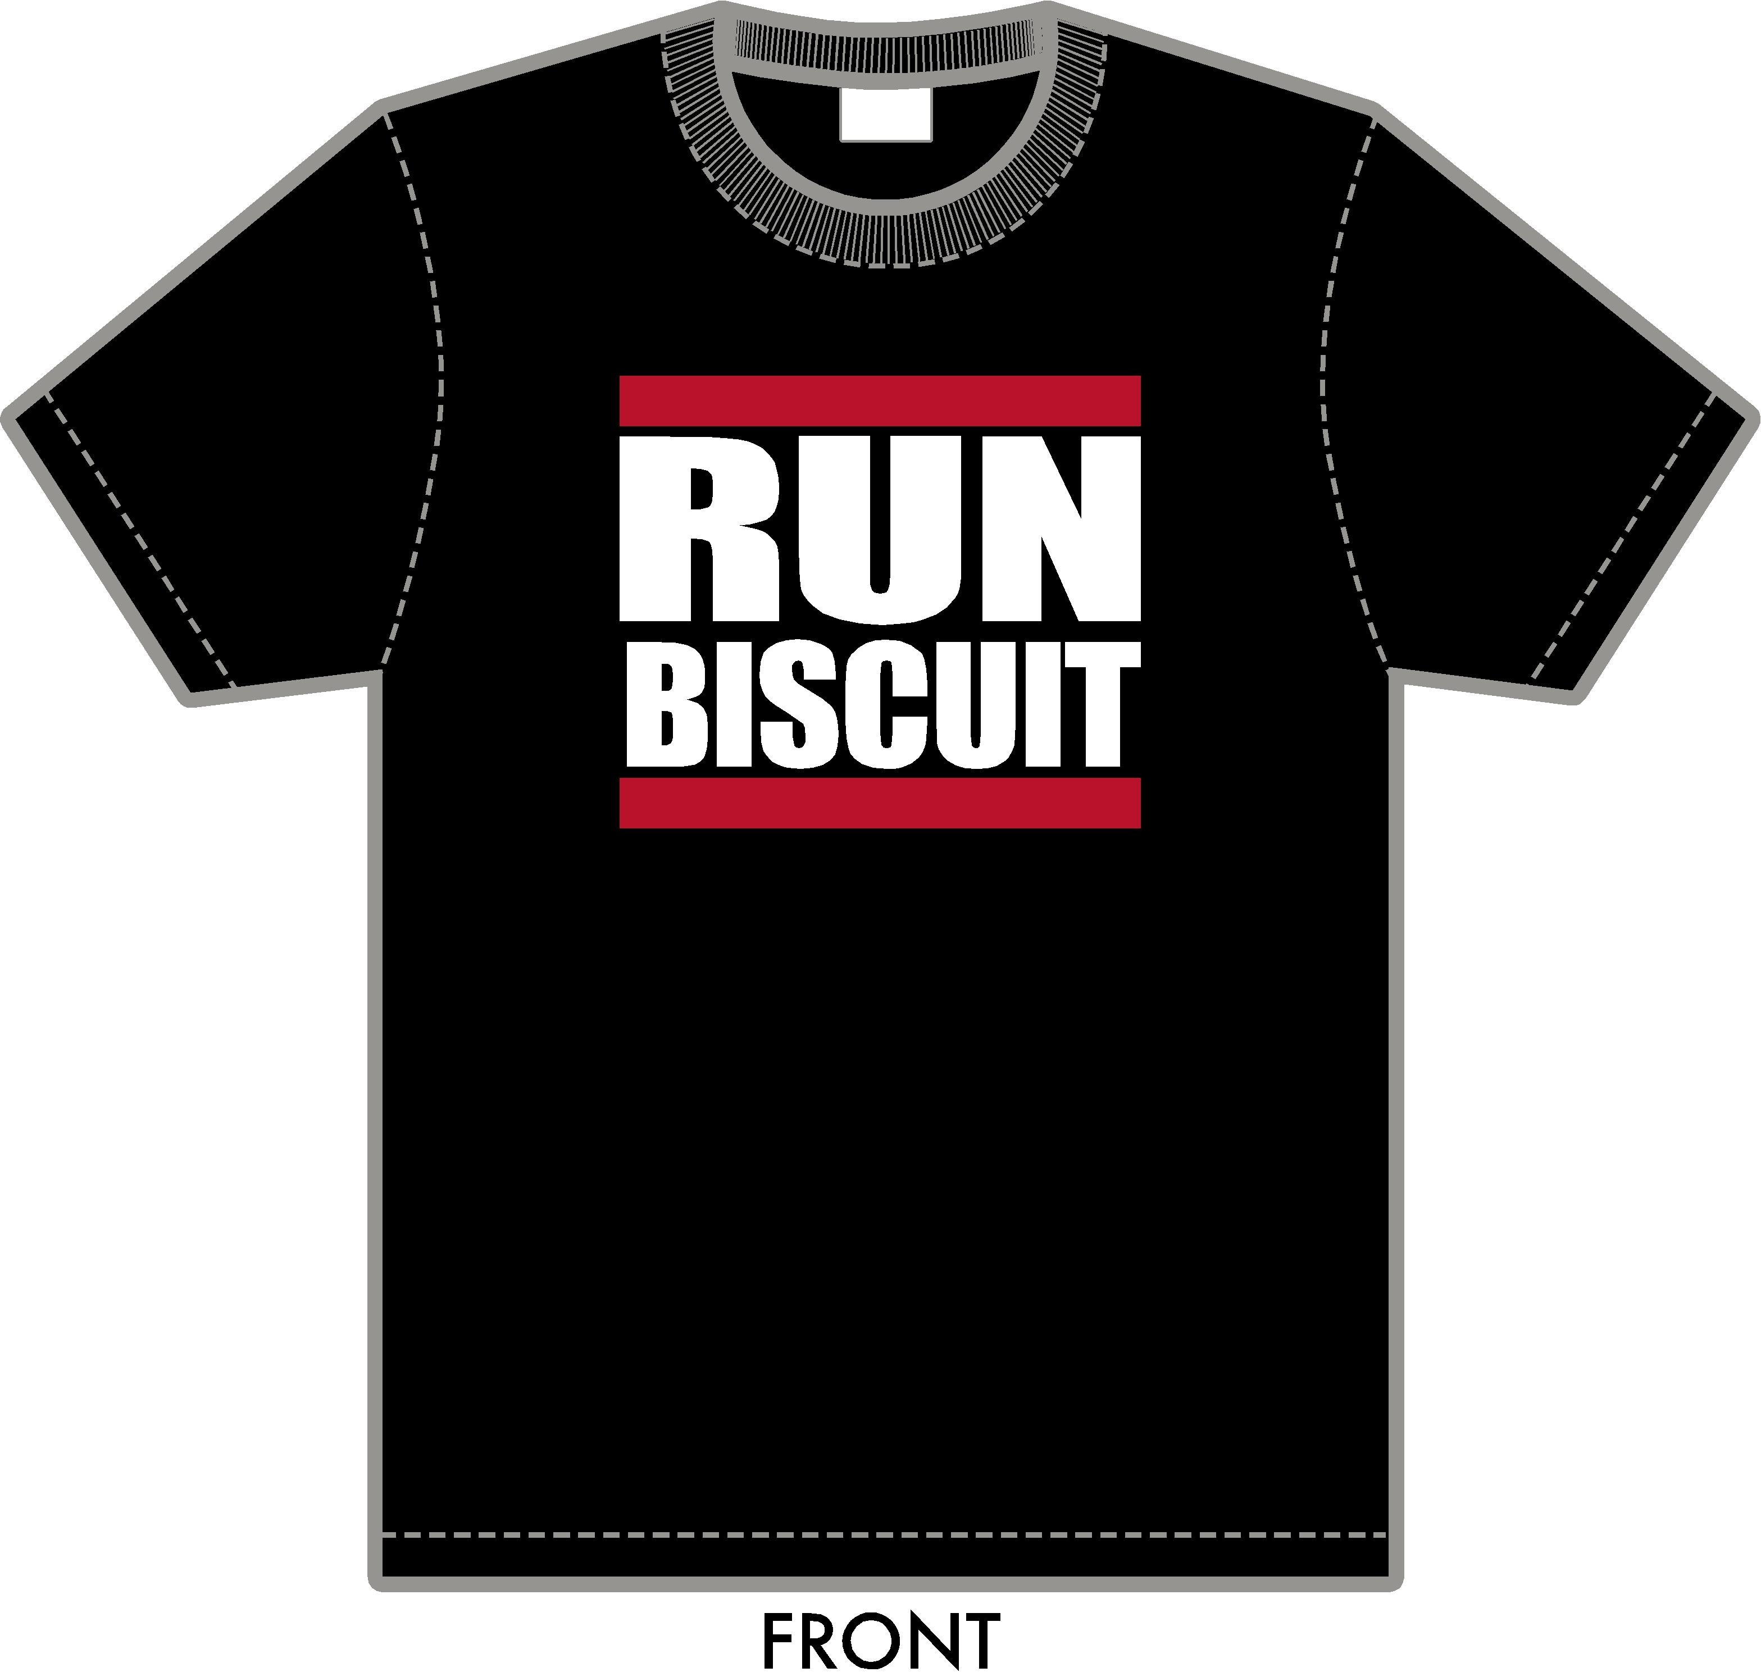
Break Time!
@debtfree
#RunBiscuit
Facebook.com/RunBiscuit
#RunBiscuit

